Slide 1
Drug-target interaction prediction using Edge2vec Algorithm on the heterogeneous network via SVM
The Fifth Iranian Conference on Signal Processing and Intelligent Systems
Authors
Fatemeh Fattahi
Mohammad S. Refahi
Corresponding
Behrouz Minaei-Bidgoli
December 2019

Slide 2
The Fifth Iranian Conference on Signal Processing and Intelligent Systems (ICSPIS 2019)
Table of Content
Introduction
Related Work
Methodology
Experimental Results
Conclusion And Future Work
Page 2 of 13

Slide 3
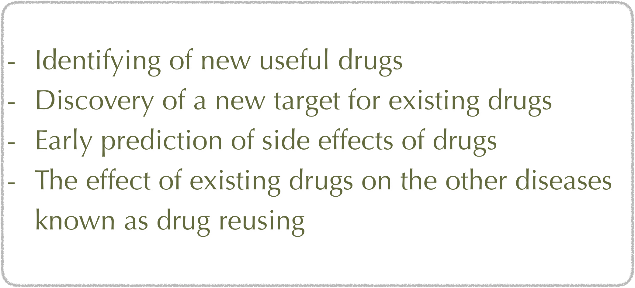
- Introduction
The Fifth Iranian Conference on Signal Processing and Intelligent Systems (ICSPIS 2019)
Drug-target protein interaction (DTI) prediction is a fundamental step in the process of drug discovery.
Goals
Page 3 of 13

Slide 4
- Introduction
The Fifth Iranian Conference on Signal Processing and Intelligent Systems (ICSPIS 2019)
- Problem solving methods
Experimental
- time-consuming
- at least 10-15 years & 800 million dollars
Computational
- useful and precise
- one type of these techniques
- Network-based approaches
Page 4 of 13

Slide 5
- Related Work
The Fifth Iranian Conference on Signal Processing and Intelligent Systems (ICSPIS 2019)
- The most renowned methods introduced to recognize DTIs
Homogeneous Networks
- B. Perozzi et al. Deepwalk: Online learning of social representations. - J. Tang et al. Line: Large-scale information network embedding. - A. Grover and J. Leskovec, node2vec: Scalable feature learning for networks.
Bipartite Models
- K. Bleakley and Y. Yamanishi, Supervised prediction of drug–target interactions
using bipartite local models.
- J.-P. Mei, C.-K. Kwoh, P. Yang, X.-L. Li, and J. Zheng, Drug–target interaction
prediction by learning from local information and neighbors.
Page 5 of 13

Slide 6
- Related Work
The Fifth Iranian Conference on Signal Processing and Intelligent Systems (ICSPIS 2019)
Other methods
Z. Xia et al. : Develop a semi-supervised learning approach named NetLapRLS that used a large number of unlabeled data in addition to the existing labeled data
van Laarhoven. et al : Gaussian interaction profile (GIP) is a kernel-based method to predict DTIs
Y.Wang and J.Zeng : The first machine learning method that was a two-layer graphical model named restricted Boltzmann machine (RBM)
Page 6 of 13

Slide 7


- Related Work
The Fifth Iranian Conference on Signal Processing and Intelligent Systems (ICSPIS 2019)
Heterogeneous Network based
Y. Dong et al. : metapath2vec: Scalable representation learning for heterogeneous networks
Defining metapaths required sufficient and comprehensive knowledge of specialists
Metapath2vec has not considered all of the metapaths at the same time
Metapath2vec has not considered edge semantics
Disadvantages
Page 7 of 13

Slide 8
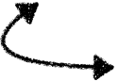
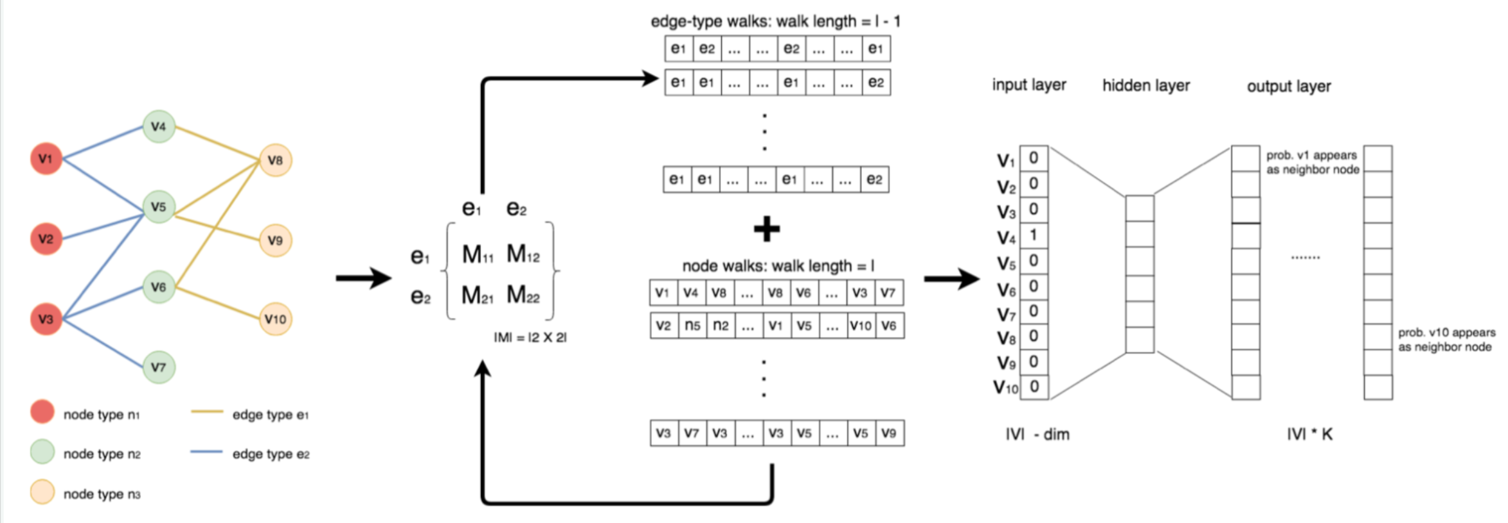
- Methodology
The Fifth Iranian Conference on Signal Processing and Intelligent Systems (ICSPIS 2019)
Heterogeneous Network based
Z. Gao et al. : edge2vec: Representation learning using edge semantics for biomedical knowledge discovery
This approach considered in addition to node concepts also edge semantics.
Page 8 of 13

Slide 9
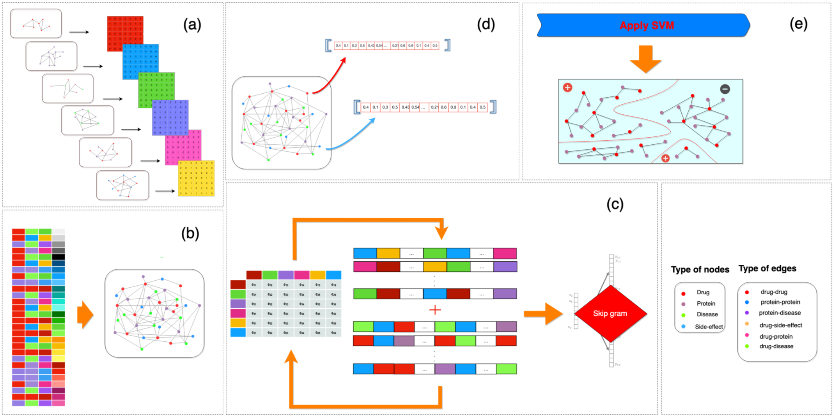
- Methodology
The Fifth Iranian Conference on Signal Processing and Intelligent Systems (ICSPIS 2019)
Page 9 of 13

Slide 10
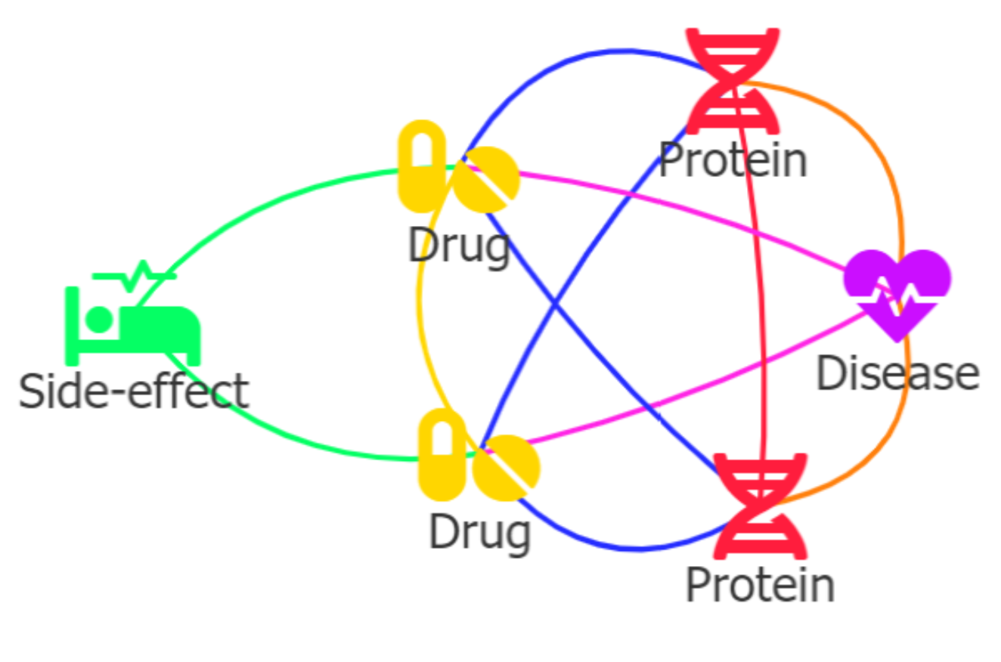
- Experimental Result
The Fifth Iranian Conference on Signal Processing and Intelligent Systems (ICSPIS 2019)
- Dataset
According to an article which is the combination of several drug-related databases
- drugs and known drug-target interactions
DrugBank database
- proteins and protein-protein interactions
HPRD database
- side effect and drug-side-effects connections
SIDER database
- disease nodes, drug-disease and protein-disease connections
Comparative
Toxicogenomics Database
Page 10 of 13

Slide 11
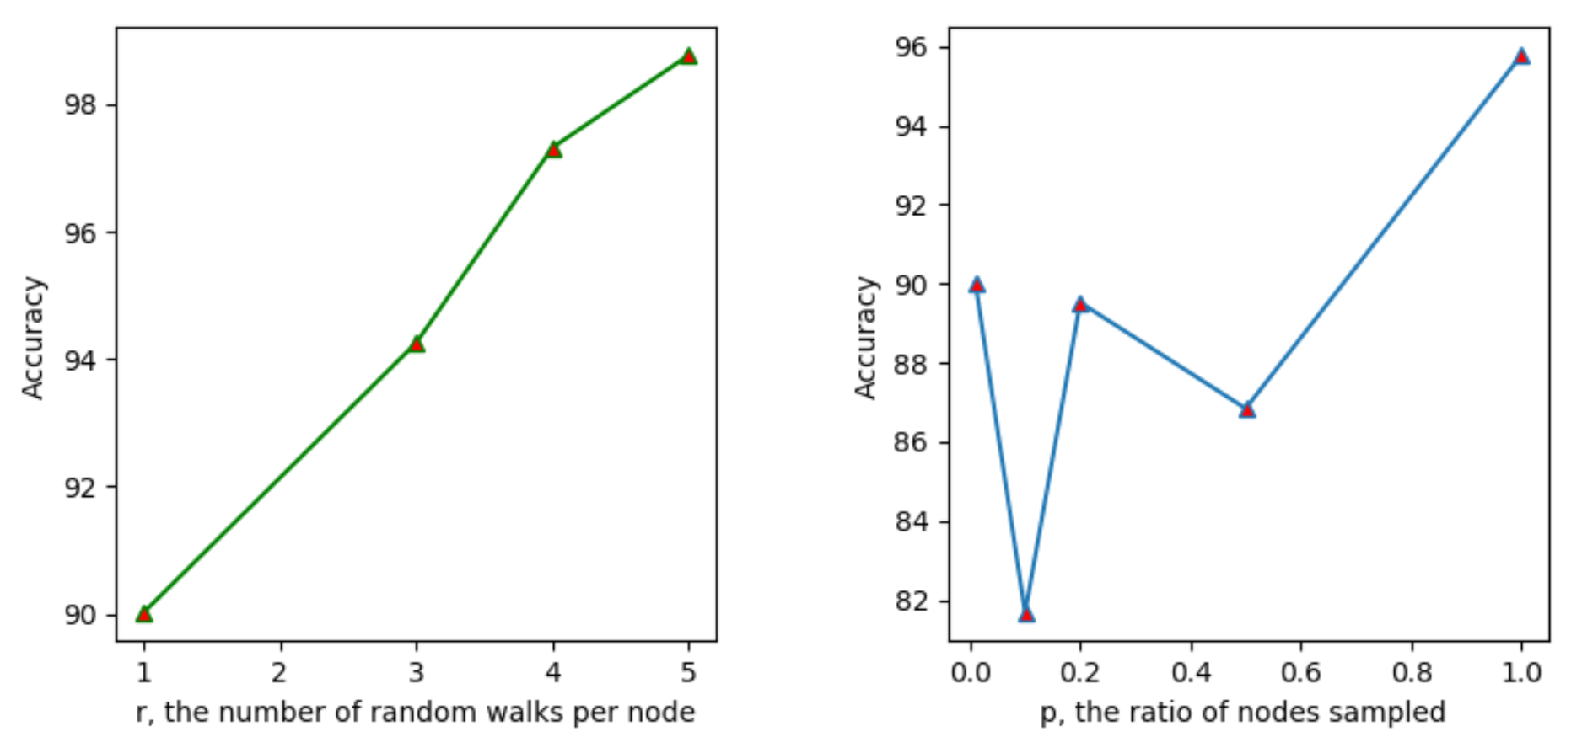

- Experimental Result
The Fifth Iranian Conference on Signal Processing and Intelligent Systems (ICSPIS 2019)
We used 10-fold cross-validation
We employed SVM by the RBF as kernel function which has two parameters C and Γ
- We adjust two parameters of Edge2vec algorithm
r
W
Parameters of Edge2vec
p
N
Page 11 of 13

Slide 12
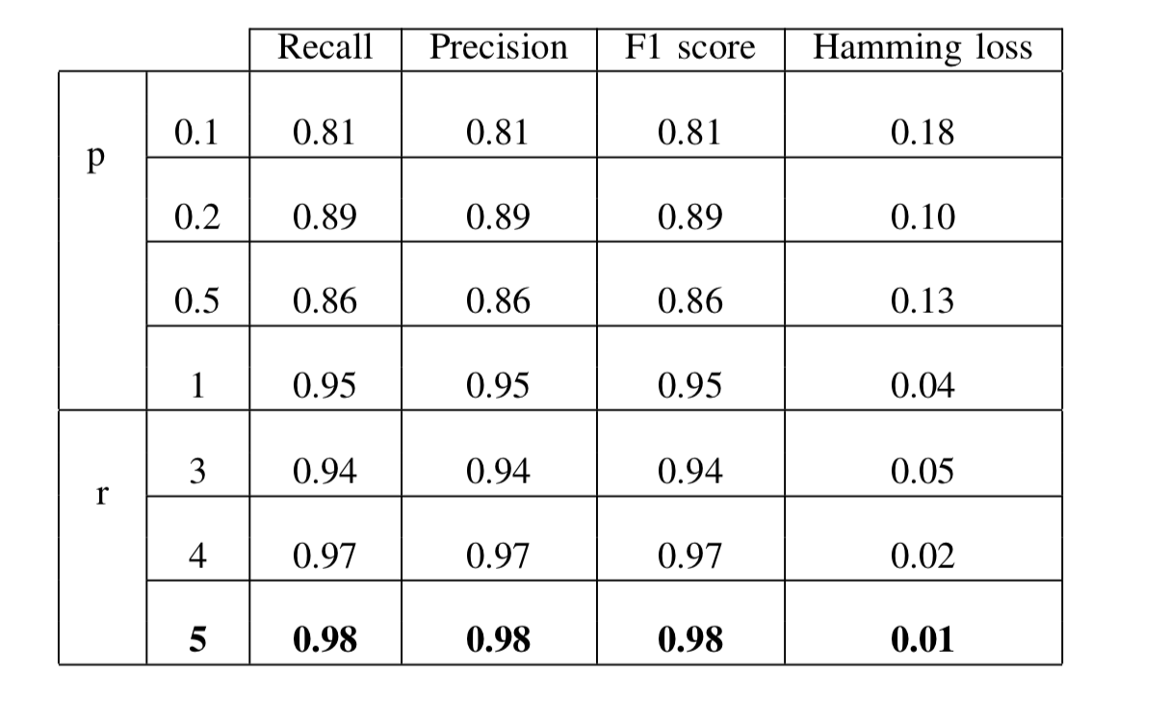
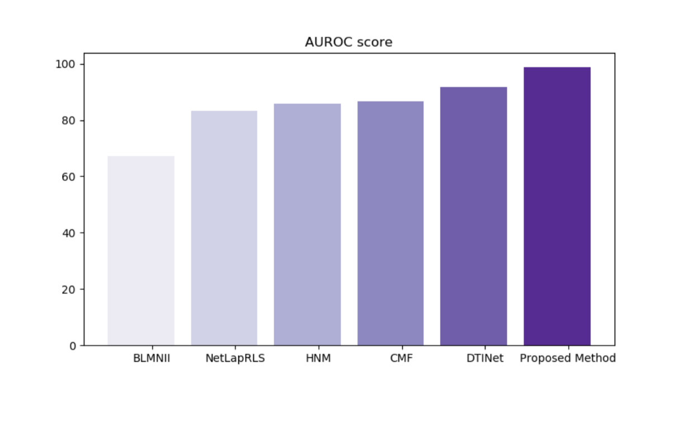
- Experimental Result
The Fifth Iranian Conference on Signal Processing and Intelligent Systems (ICSPIS 2019)
Page 12 of 13

Slide 13
- Conclusion And Future Work
The Fifth Iranian Conference on Signal Processing and Intelligent Systems (ICSPIS 2019)
- Identifying other interactions such as protein-protein interaction (PPI) and
drug-drug interaction (DDI) can be investigated by our proposed method
- Applying other biomedical heterogeneous networks on our method might yield more accuracy and predict many of the interactions between drug and target
Page 13 of 13

Slide 14
THE END

